Slide 1
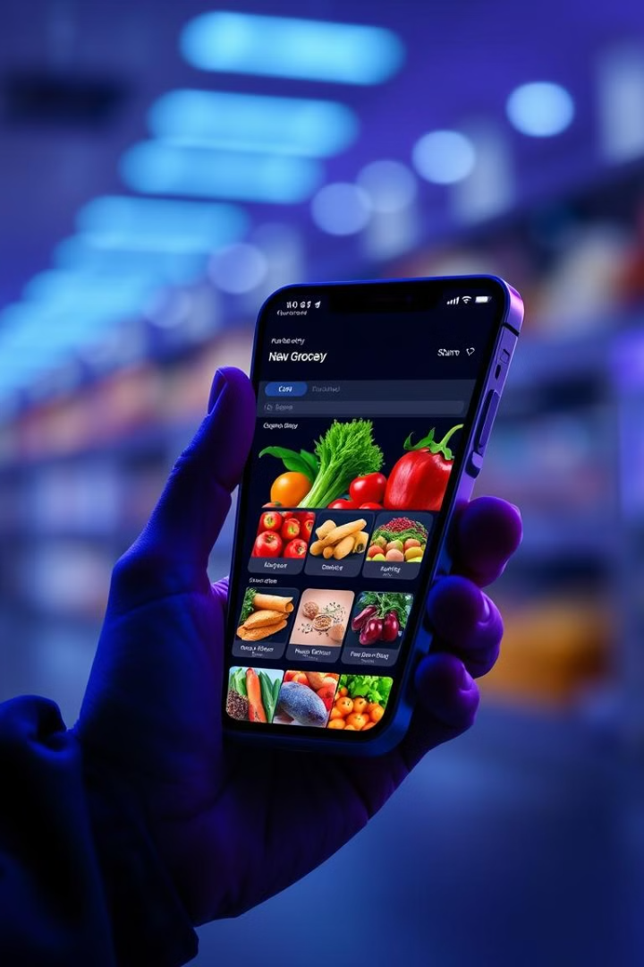
Smart Grocery: An AI Driven Online Grocery Shopping
The Smart Grocery Shopping platform is an AI-driven online grocery system designed to provide a seamless, personalized, and efficient shopping experience. It integrates features like AI-powered recipe generation, dynamic pricing, voice-activated assistance, and automated inventory management to enhance user convenience and operational efficiency. The platform supports multiple user roles, including customers, administrators, suppliers, and district operations managers, ensuring smooth order processing, stock management, and secure transactions.

Slide 2
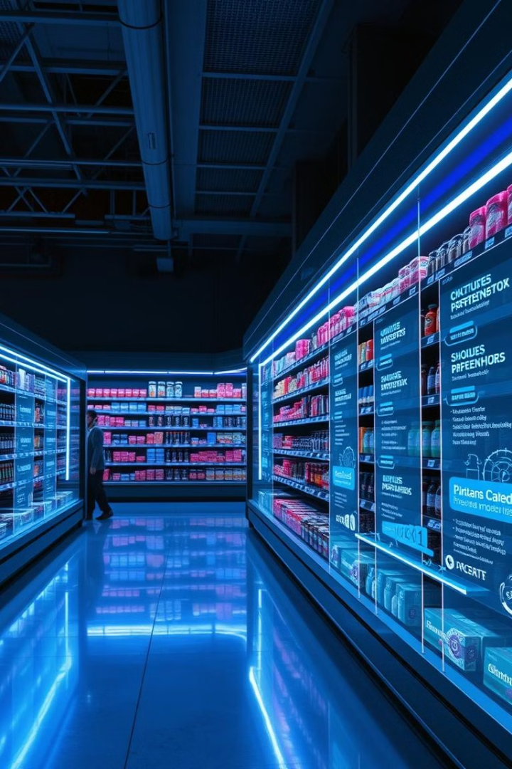

Project Overview and Objectives
1
Modernize Shopping
2
Personalized Experience
Smart Grocery aims to revolutionize traditional grocery shopping with cutting-edge technology and AI-driven features.
The platform offers tailored recommendations based on user preferences and shopping history.
3
Efficiency
Streamlined processes and real-time updates ensure a fast and convenient shopping experience.

Slide 3




User Types and Roles
Consumers
End-users who browse products, make purchases, and interact with the platform's features.
District Operations Managers
Oversee regional inventory, ensuring product availability and managing local logistics.
Administrators
Manage overall platform operations, user accounts, and monitor system performance.
Suppliers
Manages the stock orders and Supplies required products

Slide 4
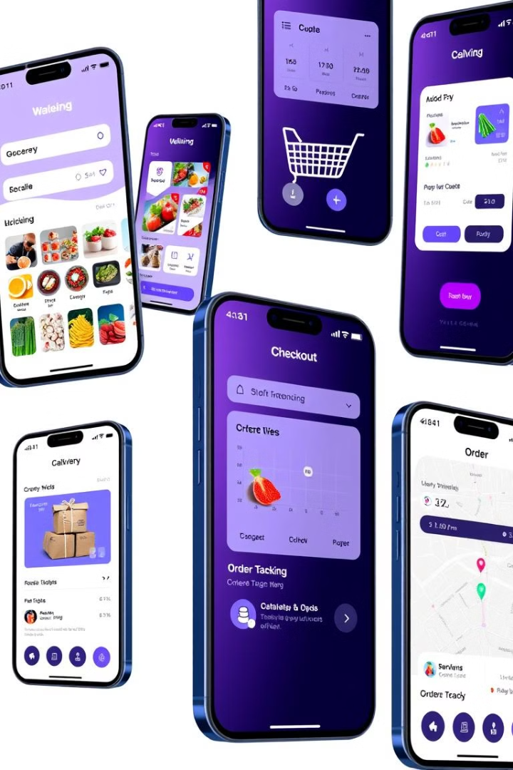
Key Functionalities
1
User Authentication
2
Smart Shopping Cart
Implements secure login and registration processes. Utilizes encryption and token-based authentication for enhanced security.
Provides real-time updates on product availability and pricing. Allows easy modification of cart contents with instant total recalculation.
3
Diverse Payment Options
4
Review System
Supports multiple payment gateways including credit cards, UPI, and digital wallets. Ensures secure transactions through encryption and tokenization.
Enables users to rate products and leave detailed reviews. Implements sentiment analysis to highlight key product features and user opinions.
5
Visual Search
6
Product Catalog:
Allows users to find products using the image of an product.
Comprehensive listings with detailed product descriptions, images, and filters for a smooth browsing experience.
7
Recipe Generation
8
Voice Assistant
Users can generate recipes based on the products they have added in the cart.
Offers hands-free shopping by enabling users to search for products, add items to the cart, and manage their orders using voice commands.

Slide 5




Technology Stack
Front-end: React.js
Builds a dynamic and responsive user interface for seamless user interactions.
Back-end: Node.js & Express.js
Manages server-side operations, API endpoints, and business logic processing.
Database: MongoDB Atlas
Stores and manages user data, product information, and transaction records efficiently.

Slide 6
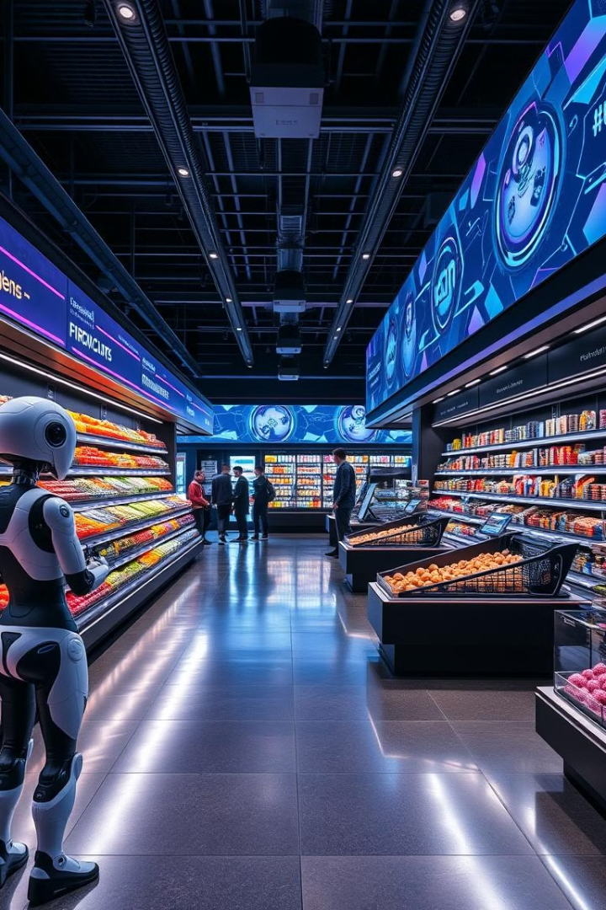
Future Enhancements
1
Nutritional Analysis and Diet Based Recommendation
Implement machine learning algorithms and AI for providing the required data.
2
Blockchain Based Supply Chain Transparency
real-time tracking of products, ensuring trust and authenticity
3
AI Driven Fraud Detection System
Enhance transaction security by identifying unusual purchasing patterns
4
Augmented Reality (AR) Based Virtual Grocery Shopping
Allows user to visualize products in 3D before purchase.
5
Autonomous Delivery Systems
Such as drone based or robotic deliveries can enhance last mile logistics
6
AI powered Smart Waste Management
Help users minimize food waste by suggesting ways to repurpose or donate items nearing expiration

